Slide 1
iPlant Cyberinfrastructure: Biological Computing using the Discovery Environment
The iPlant Collaborative
Presented by Joshua Stein
Cold Spring Harbor Laboratory, USA
1

Slide 2
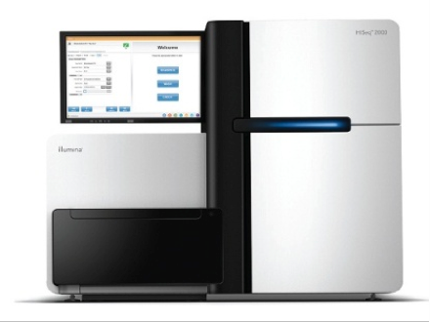
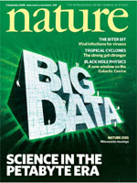
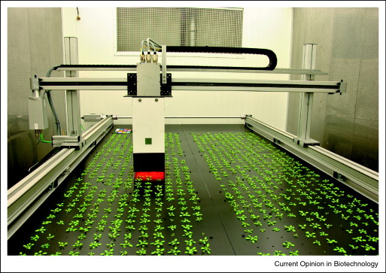

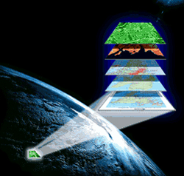


One Big Problem...
Illumina HiSeq2000
2008
High-throughput sequencing
How do we transfer, store, share, search, discover, analyze, visualize, integrate & ultimately exploit BIG DATA?
Chlorophyll fluorescence imaging
2011
High-throughput phenotyping
USDA crop-land data layers
Geospatial surveys
Notes:
http://datagateway.nrcs.usda.gov/
http://www.sciencedirect.com/science/article/pii/S0958166911007026
Problem: big data. Keeps getting bigger
In 11 Days
Generates 4TB of raw data
600,000,000,000 bases of DNA sequence
(200 human genomes)
70K for~30 camera sets
~200 movies of plants undergoing a dynamic growth process
“Only” 4GB a day

Slide 3



“Know-how” Gap
Rapidly advancing computational methods
Inefficient dependence on the resident computer guru
Need to liberate & empower bench scientists and bioinformaticians alike
Notes:
http://blogs.nature.com/soapboxscience/2012/05/30/reaching-out-science-has-a-pr-problem

Slide 4
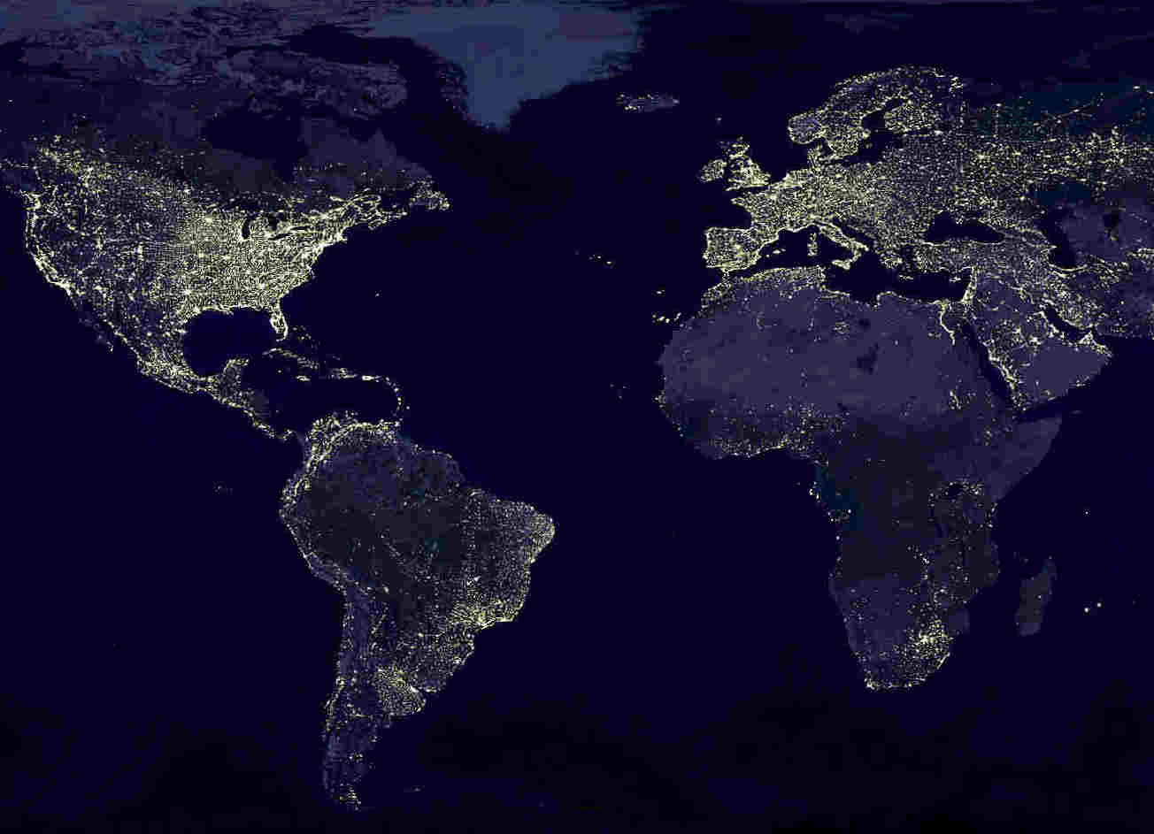
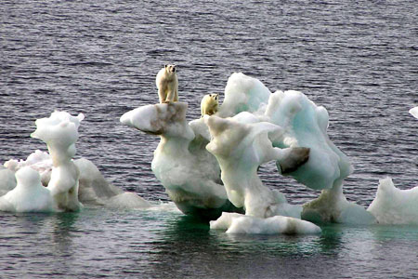
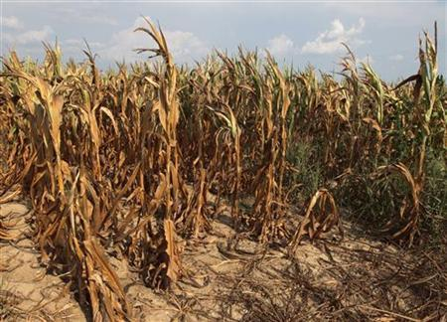
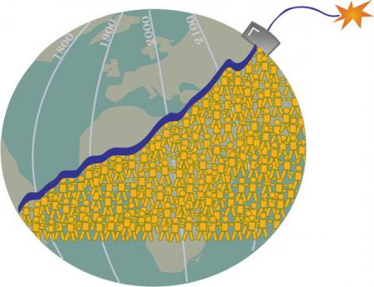
Humanity Faces Huge Challenges
Notes:
http://www.google.com/imgres?hl=en&safe=off&biw=1135&bih=617&tbm=isch&tbnid=vlNdR2Xit0swvM:&imgrefurl=http://autisminnb.blogspot.com/2011/11/autism-arctic-ice-melt-its-gotta-be.html&imgurl=http://1.bp.blogspot.com/-Sz9wgyiVEO0/Ts4Vp6GVbfI/AAAAAAAAInw/2IKLS-7gYfE/s640/polarbears_450x300.jpg&w=450&h=300&ei=UapIUIGOE-a40AG0uoCwBg&zoom=1&iact=hc&vpx=821&vpy=279&dur=4037&hovh=183&hovw=275&tx=214&ty=91&sig=102134752227230600514&page=2&tbnh=139&tbnw=184&start=18&ndsp=24&ved=1t:429,r:11,s:18,i:170
https://encrypted-tbn2.google.com/images?q=tbn:ANd9GcSdxZ1SjBr5Nev0L9LvZgELbDKaRWNNrpwPjvM6AapNze9C6eRz
http://atrophiedmind.files.wordpress.com/2011/08/population-explosion.jpg

Slide 5
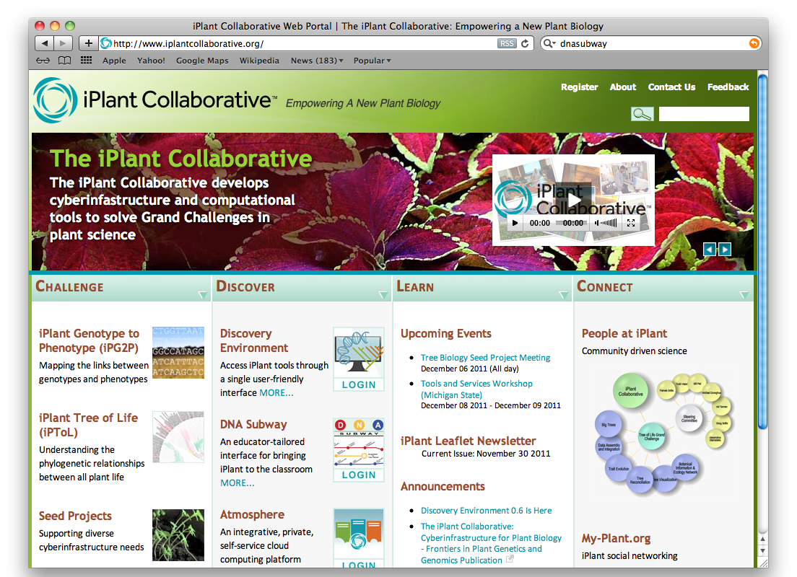
Where Can I Start?
www.iplantcollaborative.org

Slide 6
iPlant Cyberinfrastructure
Universal, accessible, capacious storage
Access to vast computing power
Sharing and collaboration
Scaling Information Visualization
Ability to integrate community software and practices

Slide 7
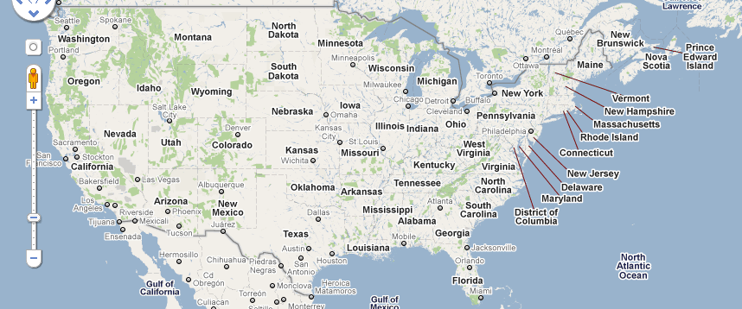
iPlant is a Virtual Organization
University of Arizona
Texas Advanced Computer Center
Cold Spring Harbor Laboratory
CSHL
UA
TACC
Example: iPlant Centers and the tree of life grand challenge collaborators

Slide 8
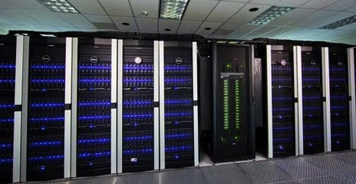
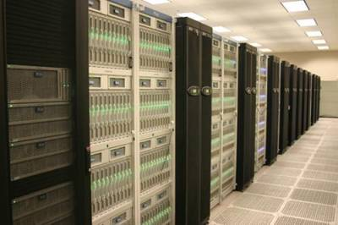
iPlant Physical Infrastructure
University of Arizona
Condor cluster
Texas Advanced Computing Center
Lonestar
Ranger
Corral
90,000 Compute Cores
Growing to ~500,000 cores by end of 2012
Up to 1TB shared memory

Slide 9
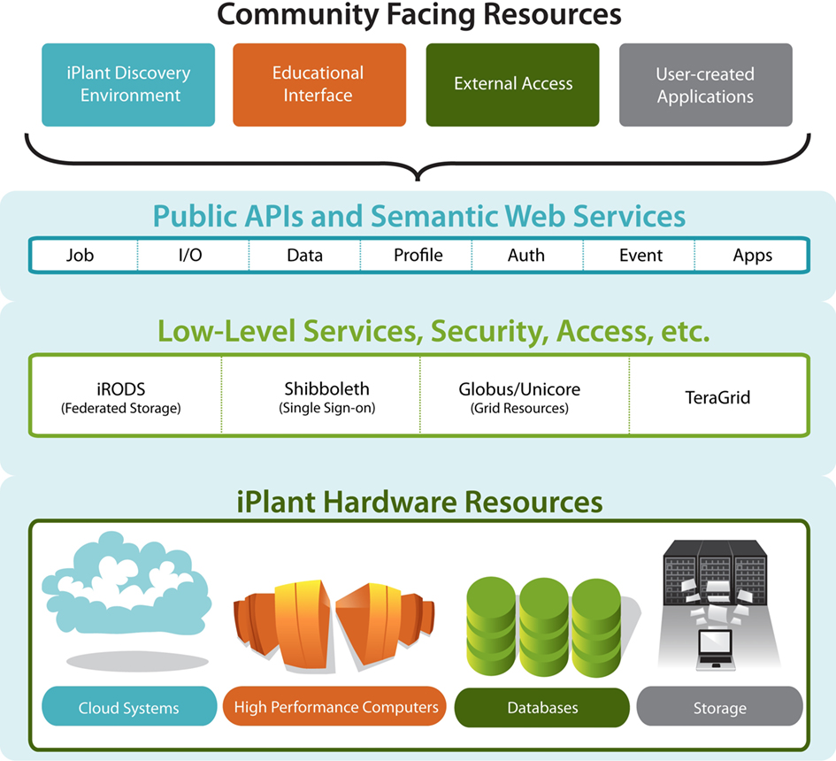
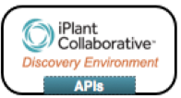
iPlant Layered Services and Access
End
Users
Computational
Users
TeraGrid
XSEDE
Resources are virtualized and federated
Notes:
iPlant layer cake of resources and services.
Bottom->Up: Hardware->low-services/middleware->APIs

Slide 10
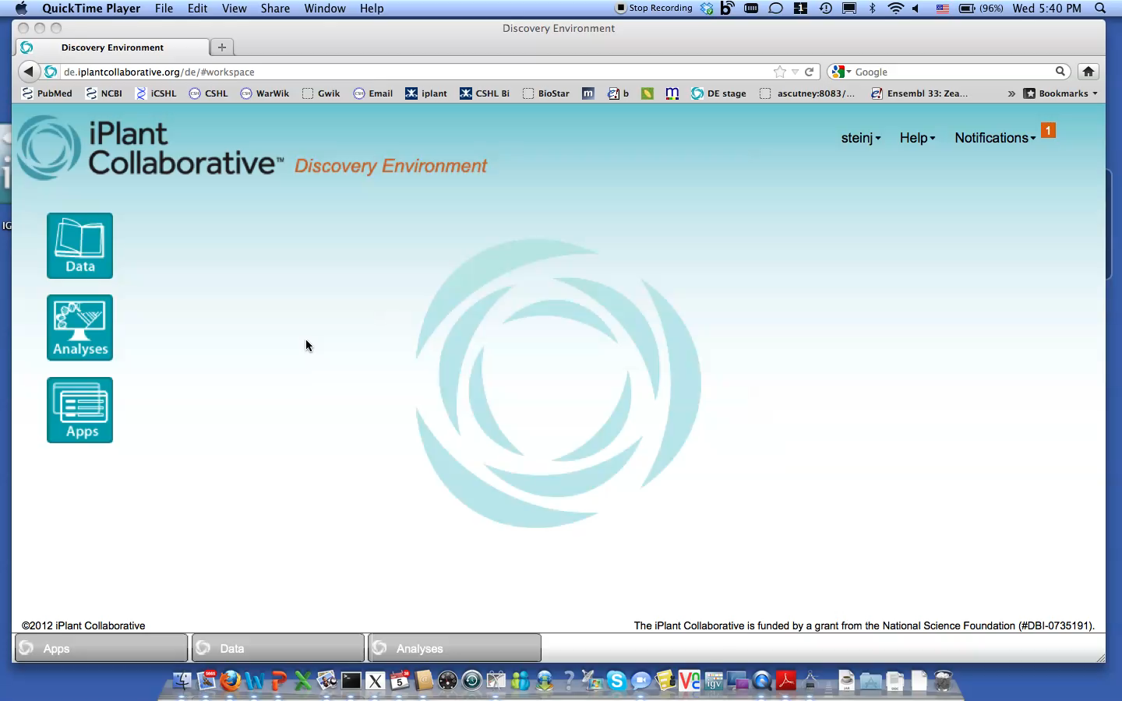
Using the Discovery Environment

Slide 11
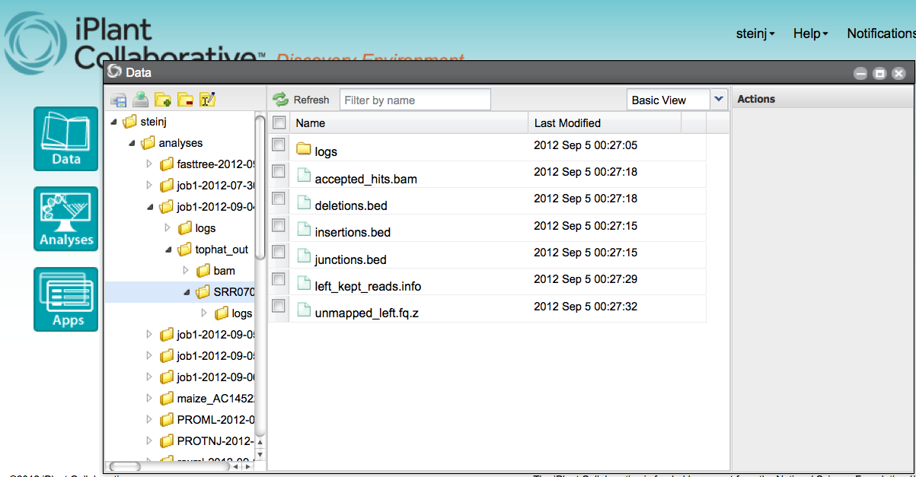
Using the Discovery Environment

Slide 12
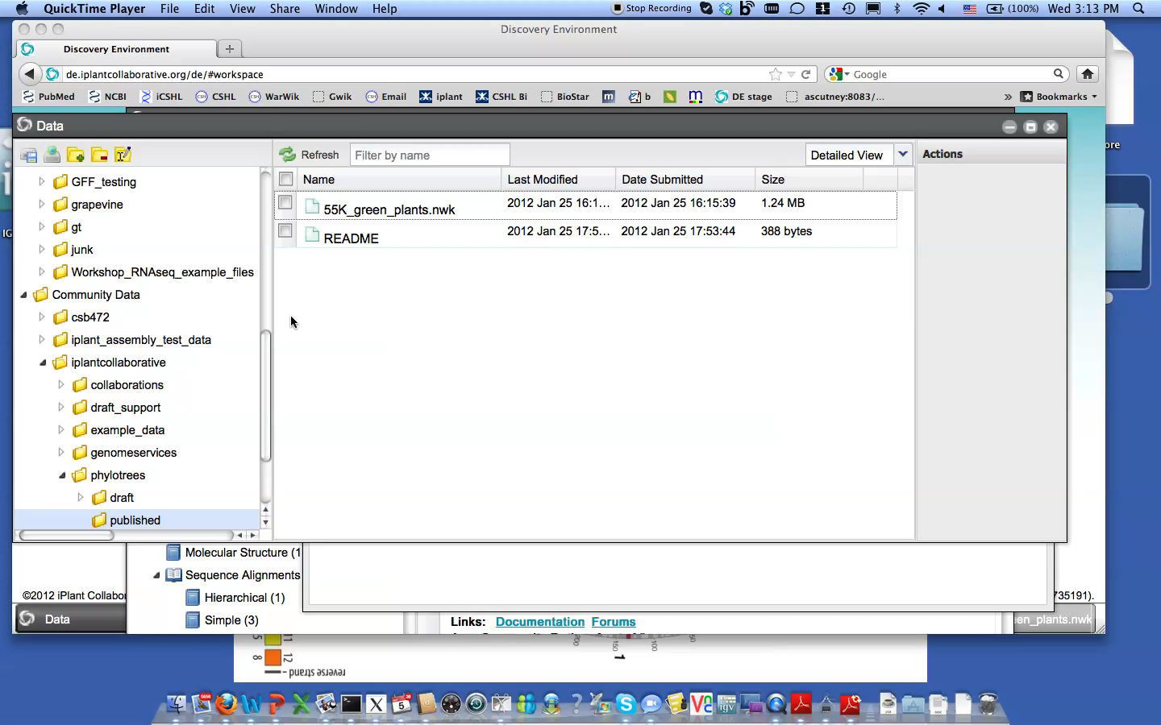
Phyloviewer: Big Tree Interactive Viewer
http://github.com/akubach/phyloviewer
55K Angiosperm mega-phylogeny:
Smith SA, Beaulieu JM, Stamatakis A, Donoghue MJ (2011) Understanding angiosperm diversification using small and large phylogenetic trees. American Journal of Botany. 2011; 98(3):404-14 doi:10.3732/ajb.1000481
12

Slide 13
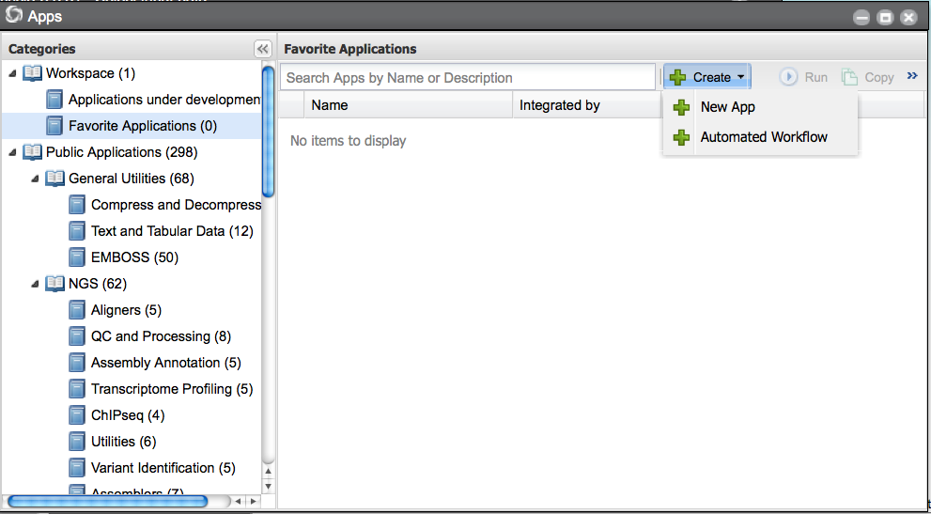
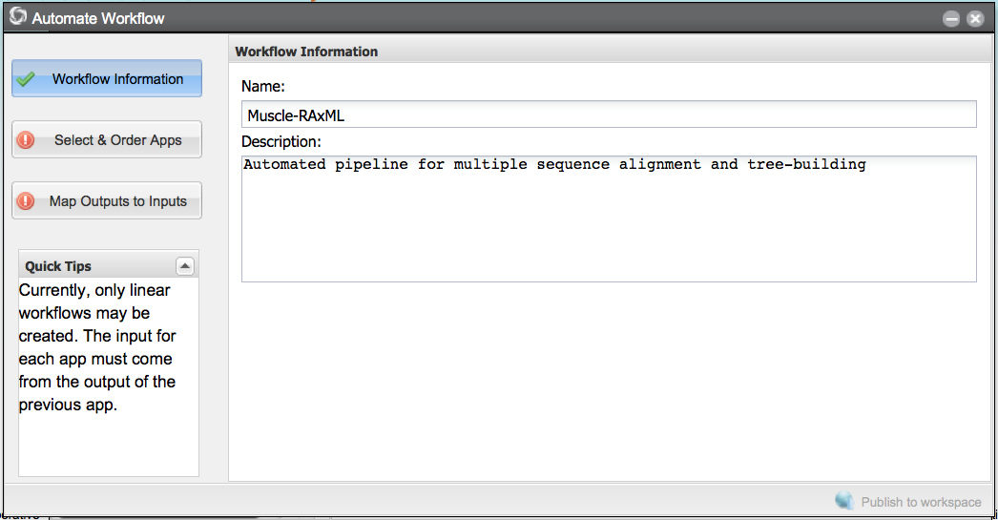
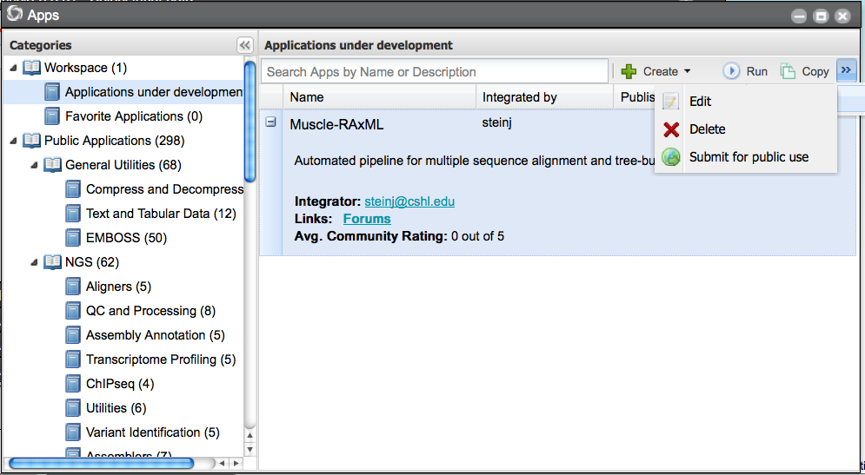
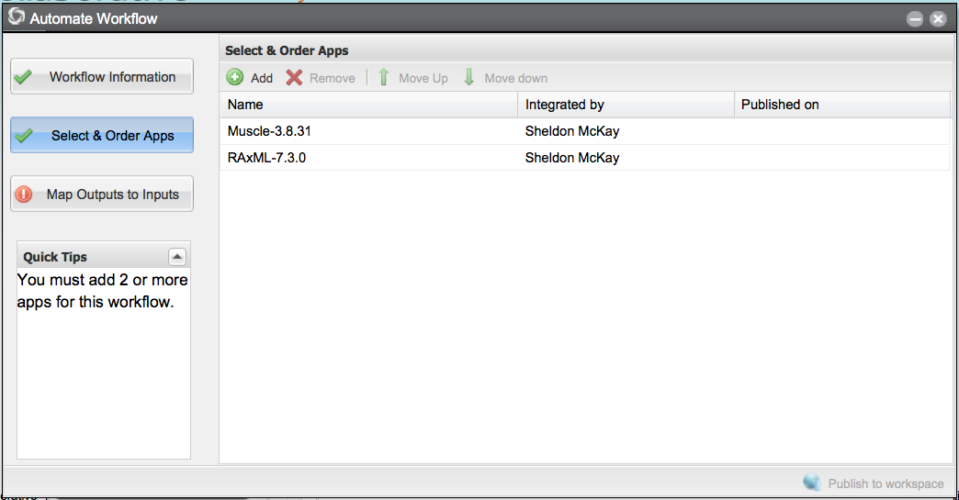
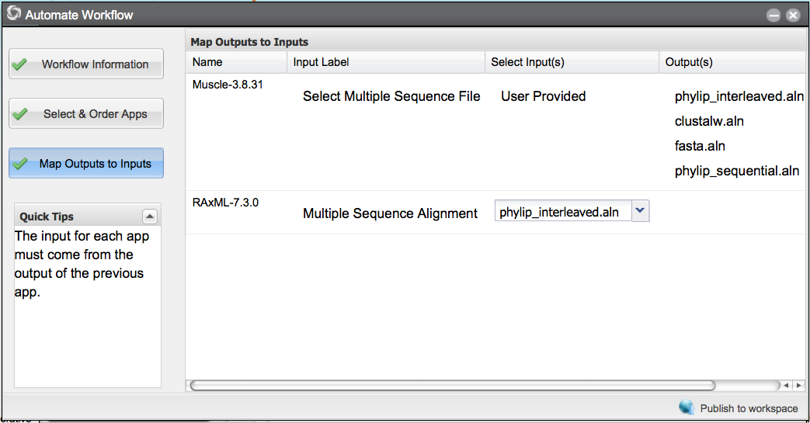
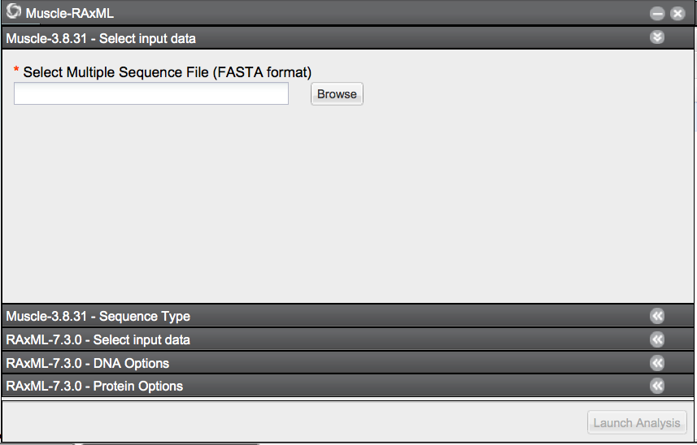
Build A Custom Workflow

Slide 14
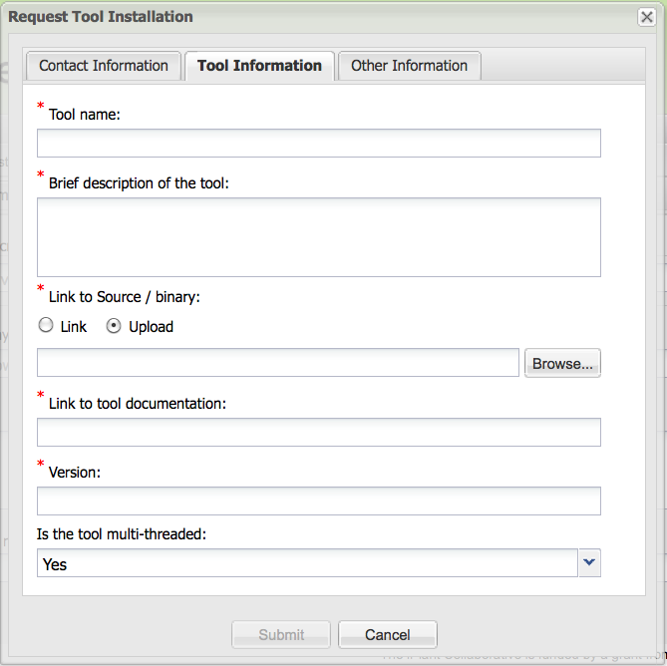
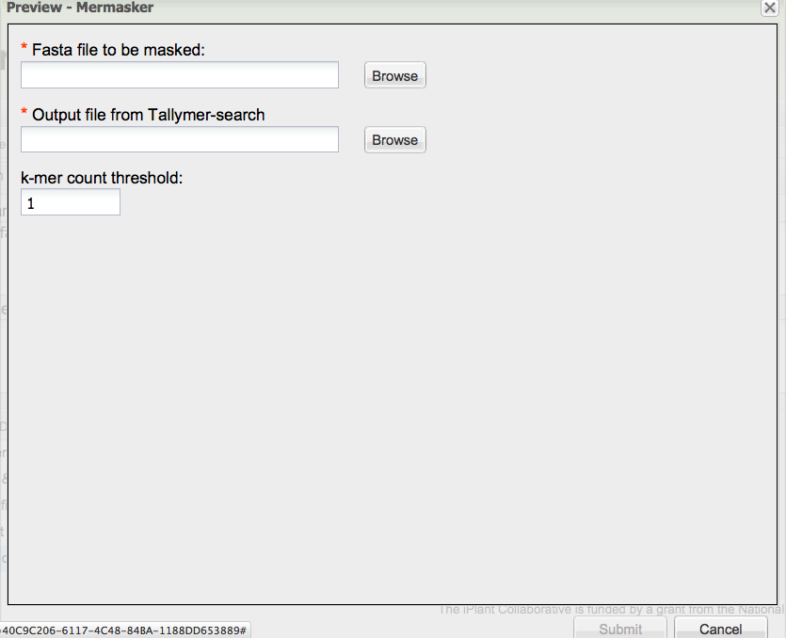
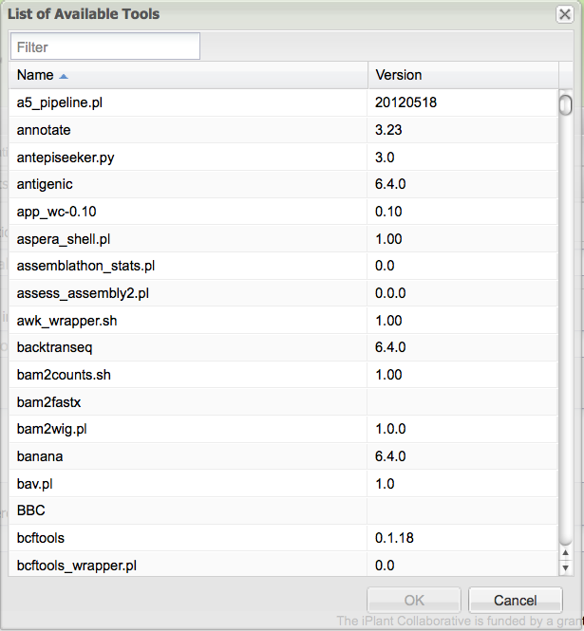
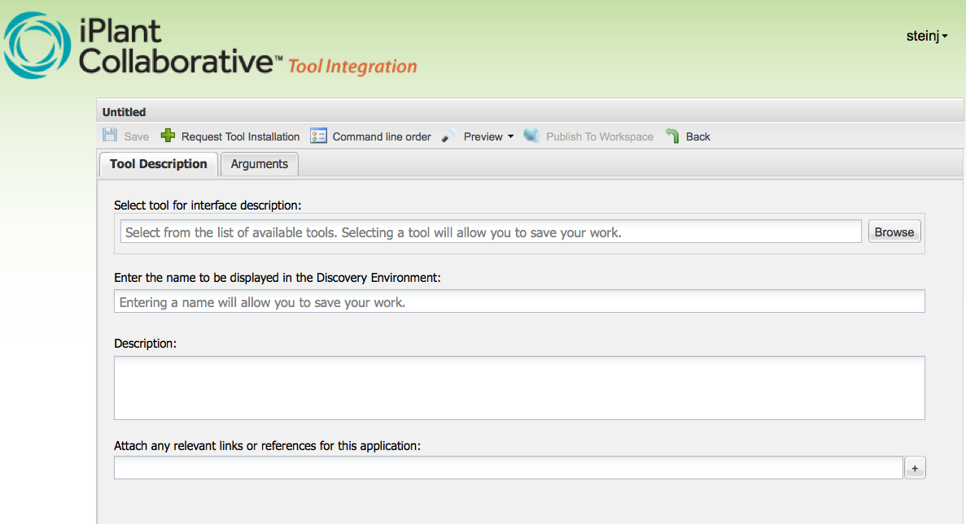
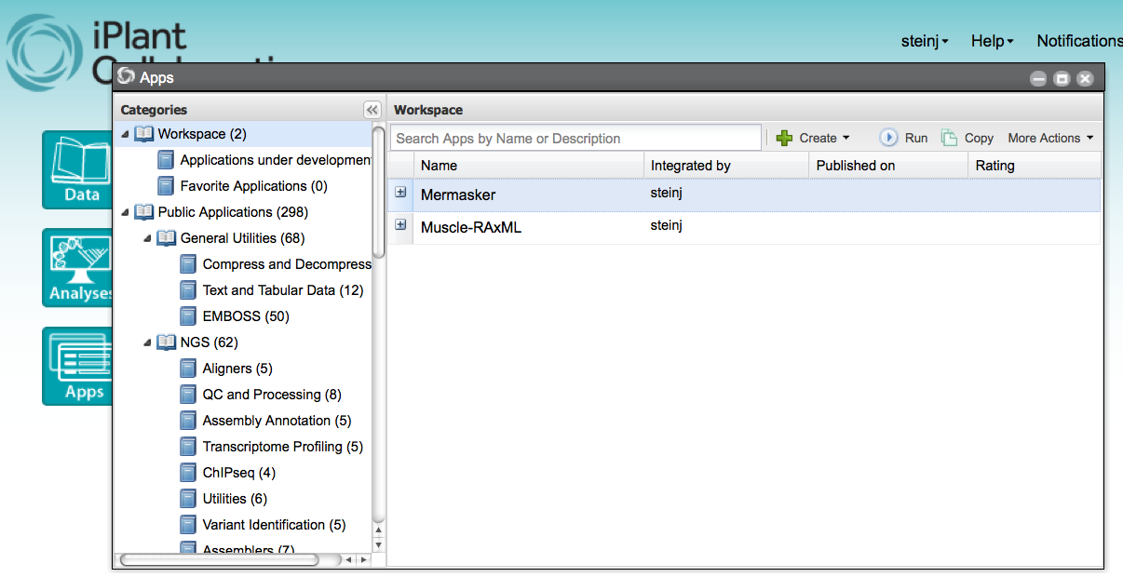
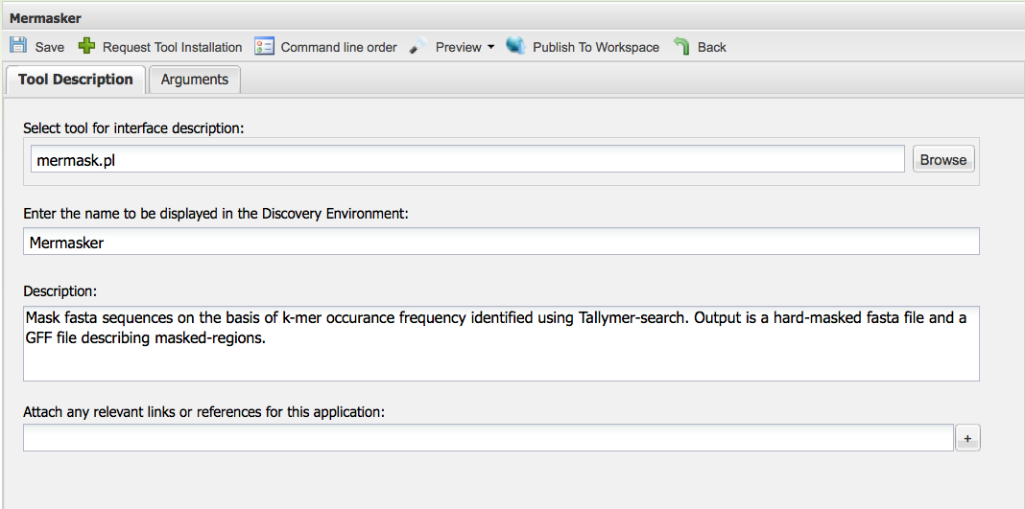
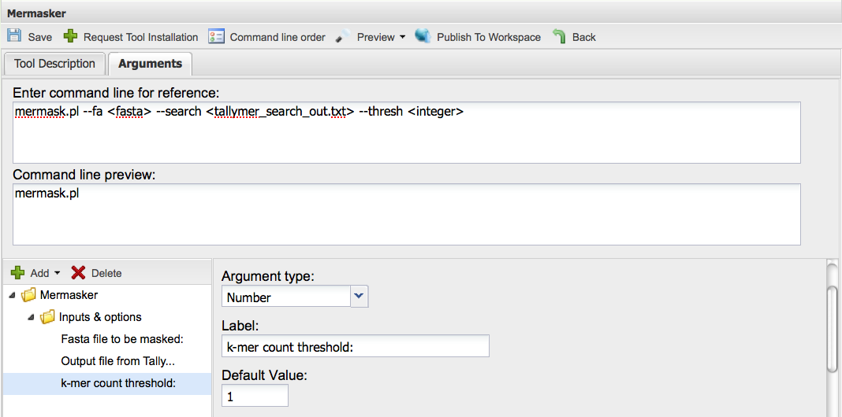
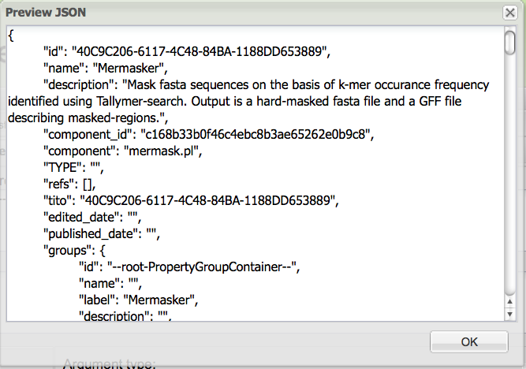
Integrating Your Own Tools

Slide 15
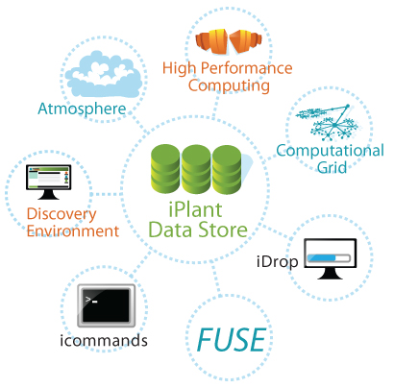
iPlant Data Store
Free Your Data
Different Users,
Different Access Needs:
One Data Store
Notes:
It is the central source for data. Connect to anything
Different users, different needs. Once Store to rule them all!

Slide 16
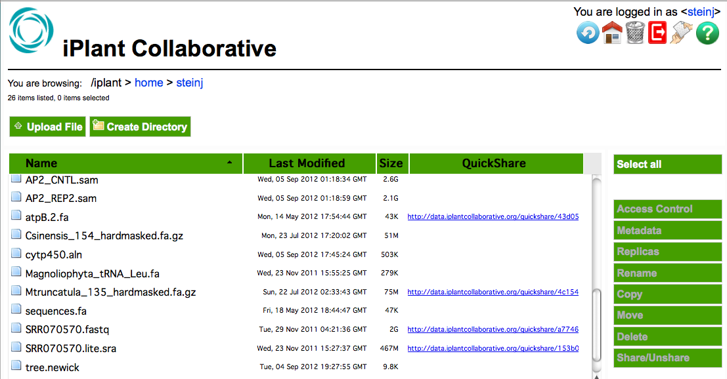
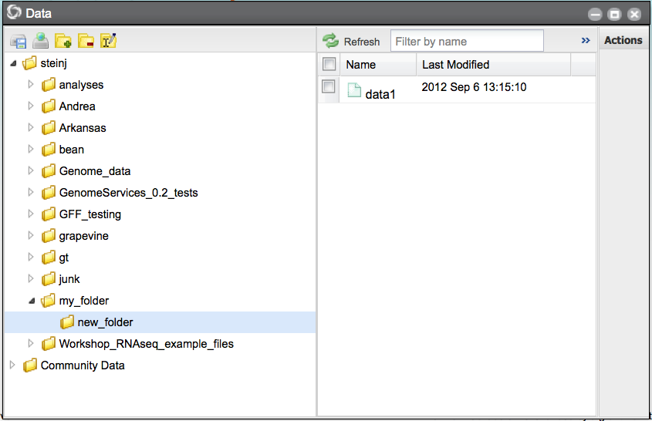
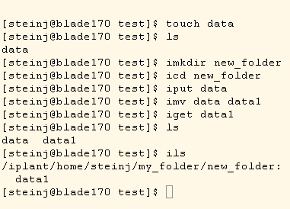
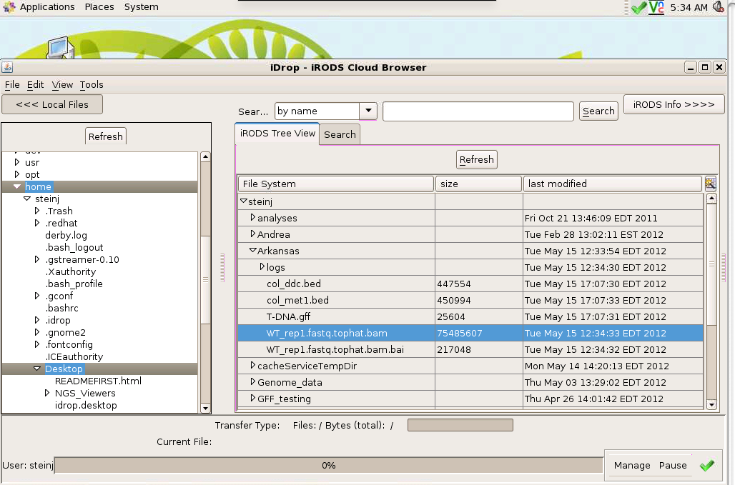
iPlant Data Store
Free Your Data
Davis Web
DE
Foundational API
i-commands
iDrop
Notes:
Different ways to connect:
WebDAV: mount a folder
DE: rich web-based client
i-commands: power! Parallel file trasnfer
iDrop: power! Parallel file transfer in a GUI
API: for programmers
HPT: High performance transfer

Slide 17
298 Open Source Applications & Counting…
Next-Gen Sequence
Transcriptome Profiling
Tuxedo Suite
ChiP-Seq
Chromatra (L&T)
MACS
PeakRanger
Assembly
Trinity
ABySS
Newbler
SCARF
SOAPdenovo
Evaluation tools
Aligners
SOAP
BLAT
BWA
QC & Processing
FASTX
FASTQC
Variant detection
SAMtools mpileup & bcftools
VCF utilities
Utilities
SAMTools
NCBI SRA Tool Kit
Phylogenetics
Tree Building
DNANJ
FastTree2
Ninja
RAxML
PROML
PROTNJ
DNAML
DNAPARS
PhyML
Comparative Methods
DACE
CONTRAST
Disparity Through Time
CACE
Evolutionary Models
Ornstein-Uhlenbeck models
PAML
Molecular Dating w/ Penalized Likelihood
Community Ecology
Picante
Utilitiies
Subset Reference Tree
TreeView
Lopper
QTL & GWAS
TASSEL suite
GBS workflow
QTL Cartographer suite
FaST-LMM
Qxpac
AntEpiSeeker
Random Jungle
Structure
PGDSpider
RNA Prediction
Infernal suite
EvoFold
TargetSpy
miRanda
PITA
Motif Identification
DREME
SequenceLOGO
Metagenomics
MetaGeneMark
MetaPhyler-SR
FragGeneScan
KronaTools ktlmportText
MetPhlan
SequenceLOGO
Other
BEDtools suite
EMBOSS suite
File utilities
Functional Analysis
Ontologizer
EMBOSS transeq
EMBOSS checktrans
PAGE
Bayesian BiClustering
EBI InterProScan (web service)
GeneMania Query Runner
eFP Batch Retrieve

Slide 18
Conclusion: Why You Should Use iPlant
Venue to bring your software to market
Optimize software to take advantage of advanced computing resources at TACC
Create synergy with existing tools
Build reproducible pipelines to share with colleagues and collaborators

Slide 19
Where Can I Start?
www.iplantcollaborative.org

Slide 20

iPlant’s Building Blocks
Postdocs:
Barbara Banbury
Jamie Estill
Bindu Joseph
Christos Noutsos
Brad Ruhfel
Stephen A. Smith
Chunlao Tang
Lin Wang
Liya Wang
Norman Wickett
Students:
Peter Bailey
Jeremy Beaulieu
Devi Bhattacharya
Storme Briscoe
Ya-Di Chen
John Donoghue
Steven Gregory
Yekatarina Khartianova
Monica Lent
Amgad Madkour
Aniruddha Marathe
Kurt Michaels
Dhanesh Prasad
Andrew Predoehl
Jose Salcedo
Shalini Sasidharan
Gregory Striemer
Jason Vandeventer
Kuan Yang
Executive Team:
Steve Goff
Dan Stanzione
Faculty Advisors & Collaborators:
Ali Akoglu
Greg Andrews
Kobus Barnard
Sue Brown
Thomas Brutnell
Michael Donoghue
Casey Dunn
Brian Enquist
Damian Gessler
Ruth Grene
John Hartman
Matthew Hudson
Dan Kliebenstein
Jim Leebens-Mack
David Lowenthal
Robert Martienssen
Staff:
Greg Abram
Sonali Aditya
Roger Barthelson
Brad Boyle
Todd Bryan
Gordon Burleigh
John Cazes
Jer-Ming Chia
Mike Conway
Karen Cranston
Rion Doodey
Andy Edmonds
Dmitry Fedorov
Michael Gatto
Utkarsh Gaur
Cornel Ghiban
Michael Gonzales
Hariolf Häfele
Matthew Hanlon
Anthony Heath
Barbara Heath
Matthew Helmke
Natalie Henriques
Uwe Hilgert
Nicole Hopkins
Eun-Sook Jeong
Logan Johnson
Chris Jordan
B.D. Kim
Kathleen Kennedy
Mohammed Khalfan
Seung-jin Kim
Lars Koersterk
Sangeeta Kuchimanchi
Kristian Kvilekval
Aruna Lakshmanan
Sue Lauter
Tina Lee
Andrew Lenards
Zhenyuan Lu
Eric Lyons
Naim Matasci
Sheldon McKay
Robert McLay
Angel Mercer
Dave Micklos
Nathan Miller
Steve Mock
Martha Narro
Praveen Nuthulapati
Shannon Oliver
Shiran Pasternak
William Peil
Titus Purdin
J.A. Raygoza Garay
Dennis Roberts
Jerry Schneider
Bruce Schumaker
Sriramu Singaram
Edwin Skidmore
Brandon Smith
Mary Margaret Sprinkle
Sriram Srinivasan
Josh Stein
Lisa Stillwell
Kris Urie
Peter Van Buren
Hans Vasquez-Gross
Matthew Vaughn
Fusheng Wei
Jason Williams
John Wregglesworth
Weijia Xu
Jill Yarmchuk
B.S. Manjunath
Nirav Merchant
David Neale
Brian O’Meara
Sudha Ram
David Salt
Mark Schildhauer
Doug Soltis
Pam Soltis
Edgar Spalding
Alexis Stamatakis
Ann Stapleton
Lincoln Stein
Val Tannen
Todd Vision
Doreen Ware
Steve Welch
Mark Westneat
74

